Slide 1
Product listing of Consumer Electronics items
mobile ,laptop, tablet
from E-commerce website Flipkart , Paytm
Made by: Mayank Vikram
Jatin Jethwa
Rohit

Slide 2
Content
Business Case
Scope
Business Benefits
Source code of Webscraping
Exploratory Data Analysis and Visualization
.

Slide 3
Business Case and Scope
Business Case:
Product listing of Consumer Electronic items Mobile, Laptop and Tablet to supply the information presented on e-commerce websites Flipkart and Paytm with strategic approach of paid a click-out model .The platform formulate revenue when visitor click and directed towards a partner Ecommerce websites.
Scope:
Displaying and comparing a vast catalog of technical specification products including price from multiple e-commerce channel Flipkart and Paytm.

Slide 4
Business Benefits
Business Benefits:
Business Benefits of the product for Visitors:
Overview of different online deals available
Saves time searching multiple websites
Specific searches for personalized results
Business Benefits of the product for Ecommerce Partner:
Increase in number of visitors and purchase of products
Monitor rates and image across distribution channels
Increase online visibility

Slide 5
Implementation and Source Code
A crawler of Web scraping was set up that could extract product prices and specifications only for predefined categories in an automated manner on a daily basis based on the schema provided by the client.
Source Code:

Slide 6
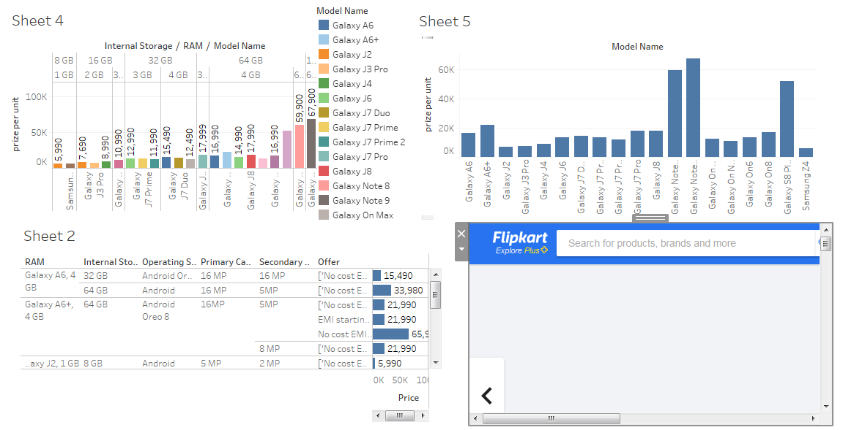
Visualization-Smart Phones

Slide 7
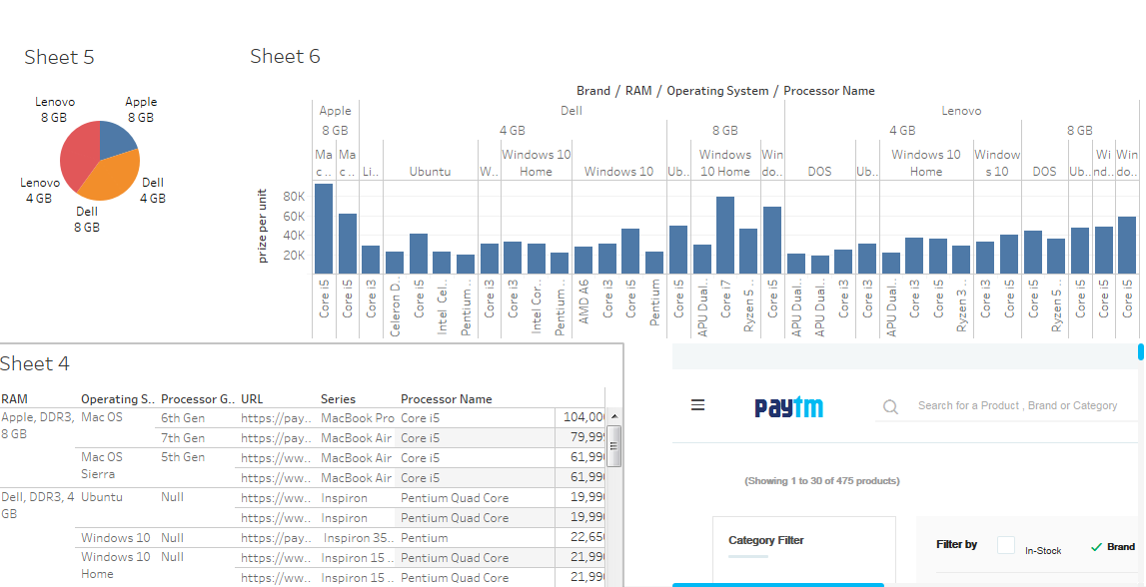
Visualization-Laptop

Slide 8
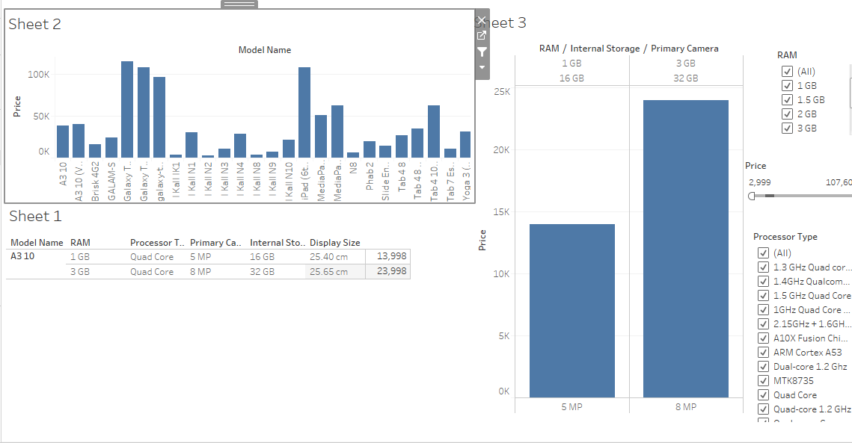
Visualization-Tablet

Slide 9
Future Scope
Sentiments analysis of User Reviews for Specific models from different online channels like Flipkart , Paytm
We can integrate open markets platforms like Justdial for increasing product listing.

Slide 10
THE END

